Slide 1
Network Intrusion Detection using Natural Language Processing and Ensemble Machine Learning
Submitted by: GM Mohaiminuzzaman Apurbo
ID: 20301100
Submitted to: Annajiat Alim Rasel
RA: Farah & Sabbir
Individual Task-1
Group-40

Slide 2
Table of contents
01
05
02
06
03
07
04
08
Introduction
Result
Motivation
Limitations
Contribution
Future Work
Methodology & Experiment
Conclusion

Slide 3
01
Introduction

Slide 4

Introduction
The document discusses a proposed intrusion detection system (NLPIDS) that utilizes natural language processing (NLP) and ensemble-based machine learning to detect network intrusions.
This system converts natural language HTTP requests into vectors using NLP techniques, allowing for the training of machine learning models to detect anomalous traffic that could indicate potential threats.
Unlike traditional intrusion detection techniques, which rely on known attack methods and patterns, the NLPIDS is capable of detecting unknown or zero-day attacks and unseen malicious traffic.

Slide 5
02
Motivation

Slide 6
Motivation
Detection of Unknown Attacks
Improved Accuracy
Reduced False Alarms
Utilization of Detailed Information
Integration with Existing Systems

Slide 7
03
Contribution

Slide 8
Contribution
Integration of ML and NLP for Enhanced Detection Accuracy
Dynamic Adaptation to Unknown Threats
Superior Performance compared to existing methods
Utilization of NLP Techniques - Word2Vec and Doc2Vec
Ensemble Models: The system employs ensemble-based machine learning models, including Ens NN, Ens DT, and Ens SVM
Efficient Data Preparation and Model Training

Slide 9
04
Methodology &
Experiment

Slide 10
Methodology
Natural Language Processing: The gensim tool is used to convert the paragraphs into vectors using the doc2vec model. This allows for the representation of the textual information in a fixed length vector format that can be used for further analysis.
Conversion of HTTP requests to Corpus: A preprocessing tool is used to extract pertinent information from the HTTP requests and translate them into English.
Construction of Vector Space Model: the documents in the corpus are then converted into vector space models using gensim.
Ensemble Machine Learning: it is a two-stage framework where supervised classifiers are used for classifying the data.

Slide 11
05
Dataset & Results

Slide 12
Dataset & Results
The HTTP DATASET CSIC 2010 is used to validate their proposed method for network intrusion detection. This dataset contains normal and anomalous HTTP requests targeted at an e-Commerce web application
The results of the experiment showed that the proposed NLPIDS outperformed existing methods in terms of its F1-score (0.999) and false alarm rate (0.007) [6a]. The system demonstrated high accuracy in detecting network intrusions, including unknown or zero-day attacks [6a].
The ensemble-based machine learning models, such as Ens NN, Ens DT, and Ens SVM, performed the best, with almost 100% sensitivity and specificity

Slide 13
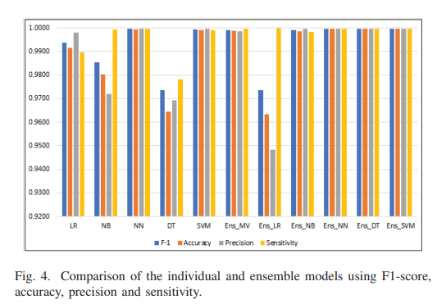
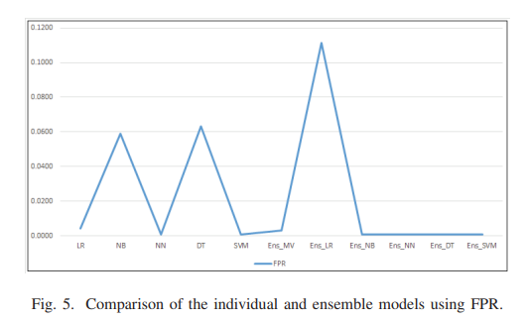
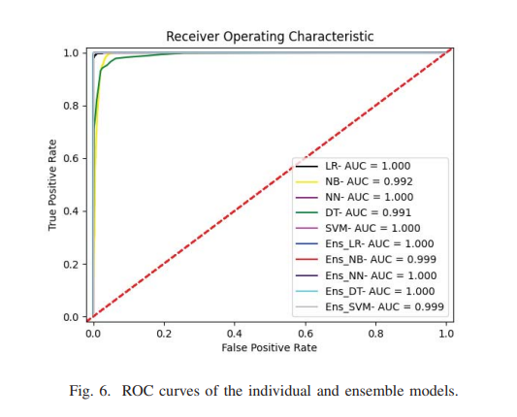

Slide 14
06
Limitations

Slide 15
Limitations
Limited dataset: The study utilizes the HTTP DATASET CSIC 2010 for validation, which may not represent all possible network intrusion scenarios. A broader and more diverse dataset would strengthen the findings and generalize the results.
Lack of scalability analysis: The scalability of the proposed NLPIDS is not addressed in the paper. It is important to evaluate how the system performs in large-scale network environments with high traffic volumes and diverse data sources

Slide 16
07
Future Works

Slide 17
Future Works
Integration with Real-Time Network Traffic: The proposed NLPIDS system uses a dataset to train and evaluate its performance. In the future, it would be interesting to integrate this system with real-time network traffic data.
Investigation of Other NLP Techniques: This document focuses on using NLP techniques such as Word2Vec and Doc2Vec for converting natural language HTTP requests into feature vectors.

Slide 18
08
Conclusion

Slide 19
Conclusion
The evaluation metrics values for different classifier models and the corresponding graph depicts the values for F1-score, accuracy, precision and sensitivity.
After comparing performance of all the eleven models, the best performing model has been retained to be deployed as part of NLPIDS for real-time intrusion detection.
To conclude, it can be said that the addition of the NLP and ensemble ML techniques into IDS have resulted in gaining more accurate experimental results.

Slide 20
References
[25] - The dataset used for experimental validation of the proposed method is the HTTP DATASET CSIC 2010 web penetration and hacking dataset consisting of normal and anomalous HTTP requests.
[14] - Lilleberg et al. proposed a text classification using support vector machine (SVM) and word2vec. They showed that the combination of word2vec and tf-idf outperforms tf-idf. Although they did not mention SVM or any ML classification model, their work is relevant to the dataset.
[15] - Min et al. implemented an NIDS based on text-convolutional neural network (CNN) and random forest (RF) using statistical and payload features. They used the ISCX2012 dataset and random forest for classification.
[16] - Mimura et al. proposed a network interface packet analysis method using source and destination IP in their NLP. Their work does not make a significant difference in detecting anomalies, but it is mentioned in relation to the dataset.
[18] - Althubiti et al. used six different ML methods, including random forest, logistic regression, J48, ABc, SGDc, and NB, to analyze the HTTP DATASET CSIC 2010 dataset. They found random forest to be the best-performing model with a high F1-score.

Slide 21
Thanks for Watching

